Slide 1
AutoGluon-TimeSeries
NEURIPS EXPO WORKSHOP, 10.12.2024
Abdul Fatir Ansari
Senior Applied Scientist, AWS

Slide 2
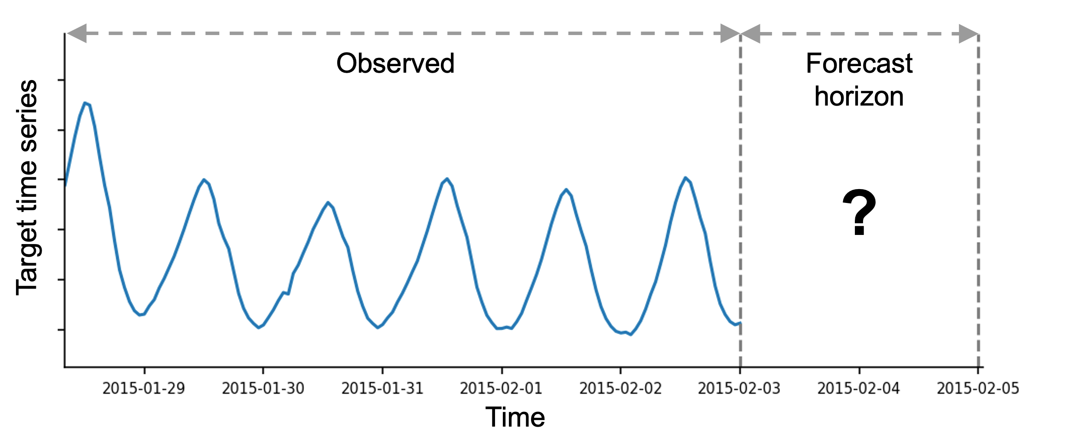
Time series forecasting
What will happen in the future given the past?

Slide 3
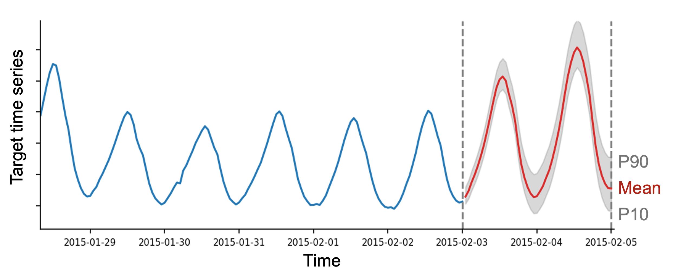
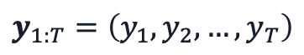
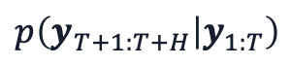
Probabilistic forecasting
Probabilistic forecast captures uncertainty in predictions
$$y_{1:T}=\left(y_{1},y_{2},…,y_{T}\right)$$
$$p\left(y_{T+1:T+H} | y_{1:T}\right)$$

Slide 4
Forecast in 3 lines of code
from autogluon.timeseries import TimeSeriesPredictor
predictor = TimeSeriesPredictor(prediction_length=14)
predictor.fit("train.csv", time_limit=600)
forecast = predictor.predict("train.csv")

Slide 5





What happens inside fit()?
Train a diverse portfolio of models
Statistical, ML, and DL forecasting models
Pretrained models
Combine them into an ensemble
Greedy weighted ensemble fit on the validation set
No hyperparameter tuning!

Slide 6
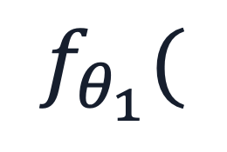
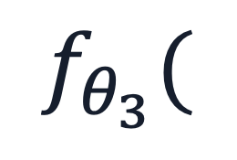
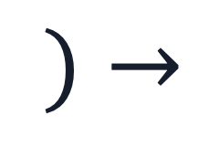
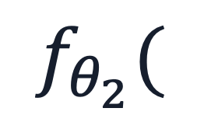

Local models
Fit a separate model for each individual time series
Examples: ARIMA, ETS, Theta
Strong baseline (esp. limited data)
Often interpretable
Low flexibility
Slow inference
$$f_{θ_{1}}($$
$$)→$$
$$f_{θ_{2}}($$
$$)→$$
$$f_{θ_{3}}($$
$$)→$$

Slide 7
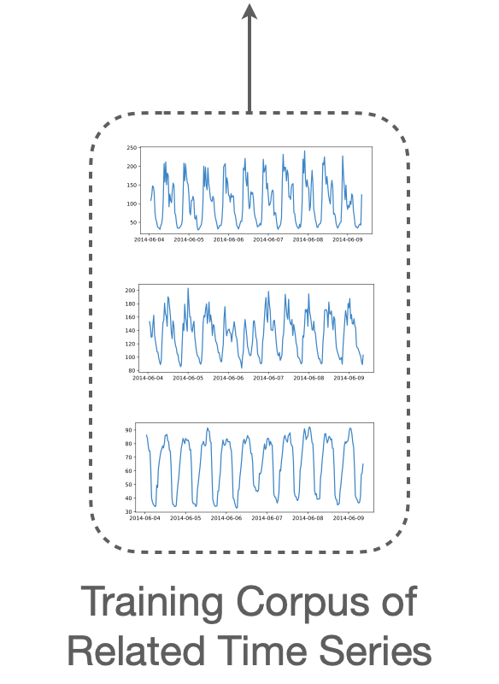
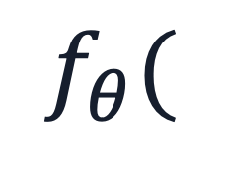
Global models
Fit a single model for each task
Examples: DeepAR, TFT, PatchTST
High flexibility
Fast inference
Slow training
Data hungry
$$f_{θ}($$
$$)→$$

Slide 8
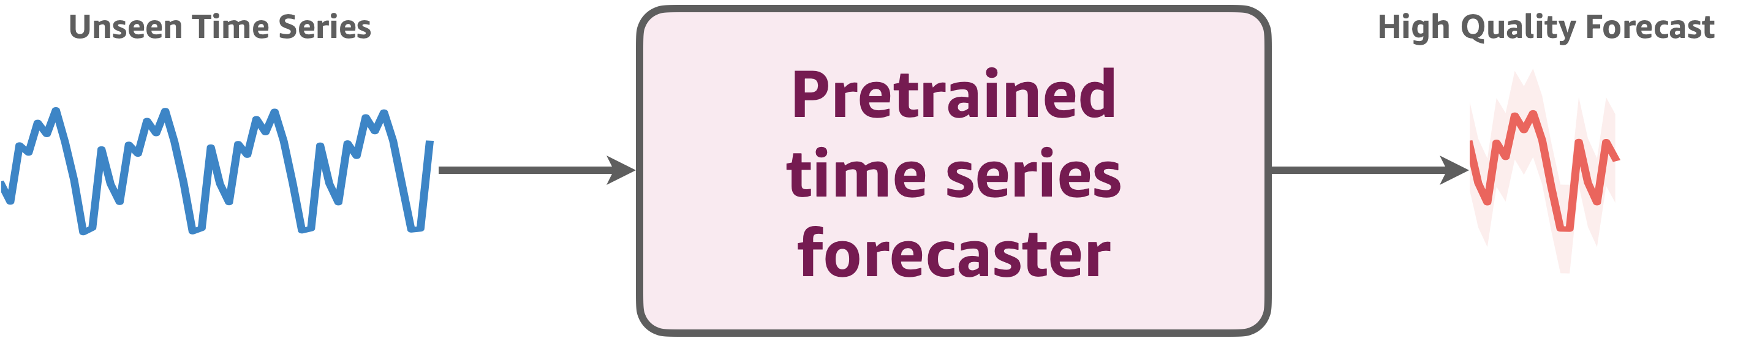
Pretrained models
Can we develop a single model that both
requires no dataset-specific training and
performs well on new time series tasks?

Slide 9
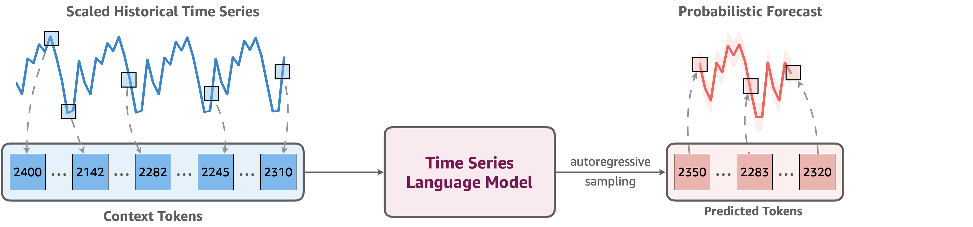
Introducing Chronos
Main idea: Convert time series into sequences of discrete tokens

Slide 10
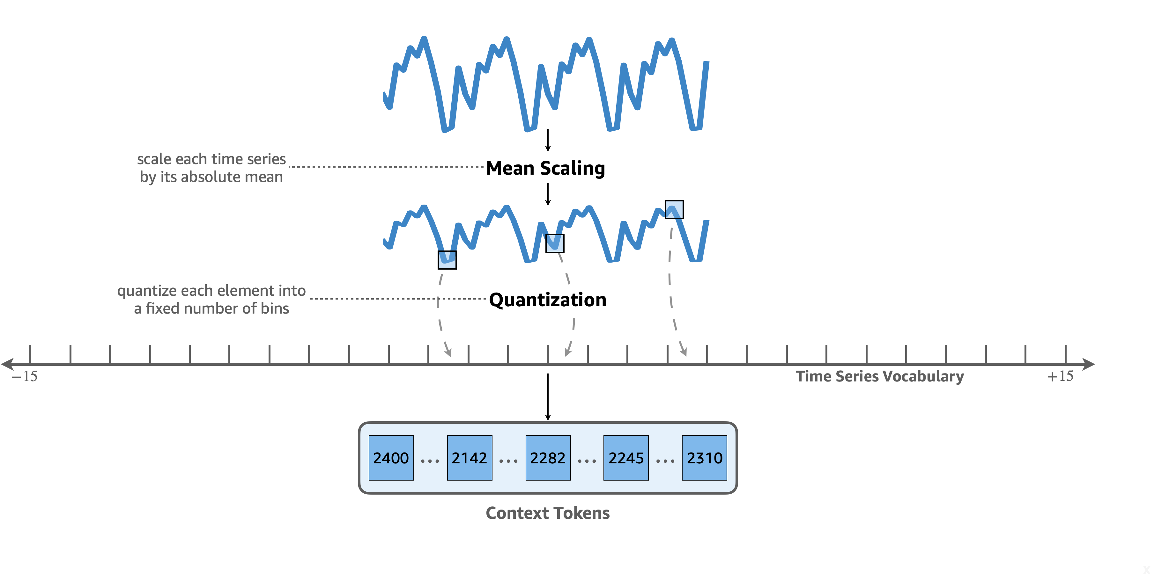
Time series tokenization

Slide 11
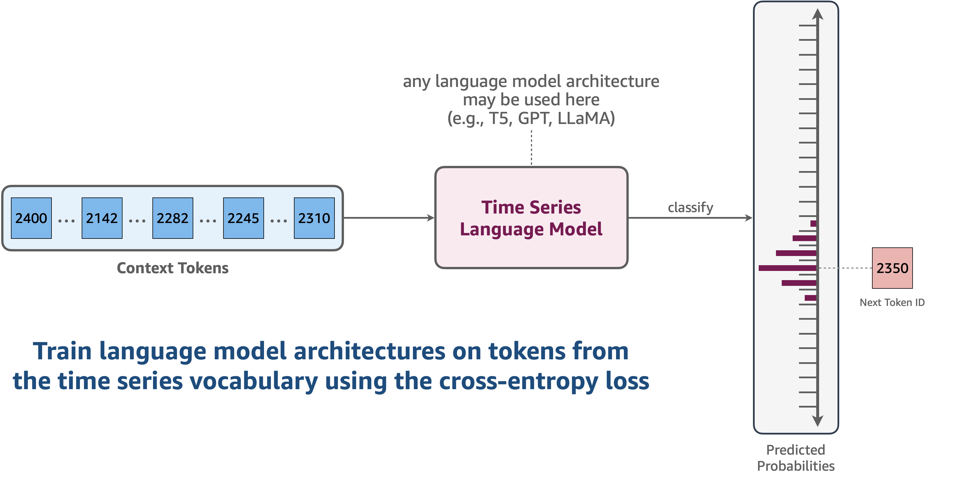
Regression via classification

Slide 12
The complete Chronos framework
Requires no changes to the language model architecture & training procedure
Probabilistic by design

Slide 13
Training datasets
28 datasets from various domains and frequencies
890K time series with 84B observations

Slide 14
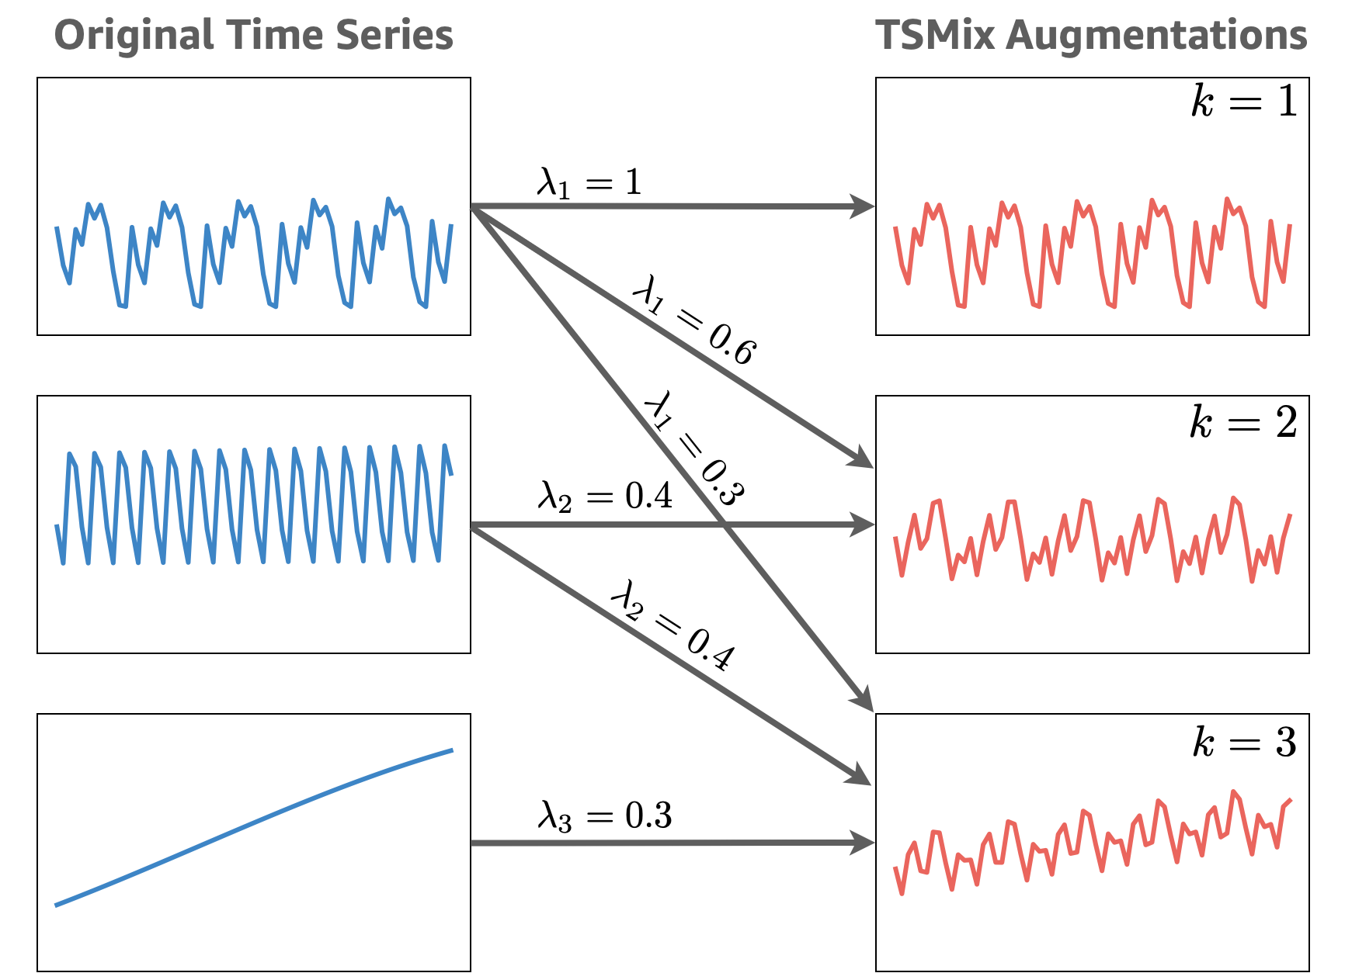
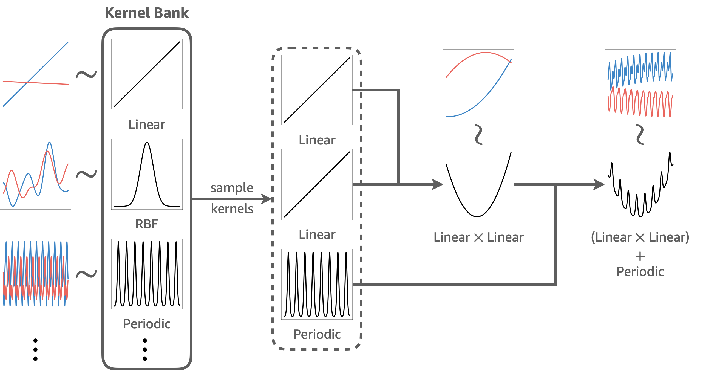
Augmenting the training set
TSMixup augmentations
Synthetic data
Improve pattern diversity by mixing time series from different datasets
Generate synthetic time series from Gaussian processes

Slide 15


Chronos in the open source
Training, inference & evaluation code available on GitHub
Model weights & training data available on Hugging Face 🤗
Run Chronos with 1 line of code using AutoGluon
Downloaded 120M+ times on Hugging Face 🤗

Slide 16
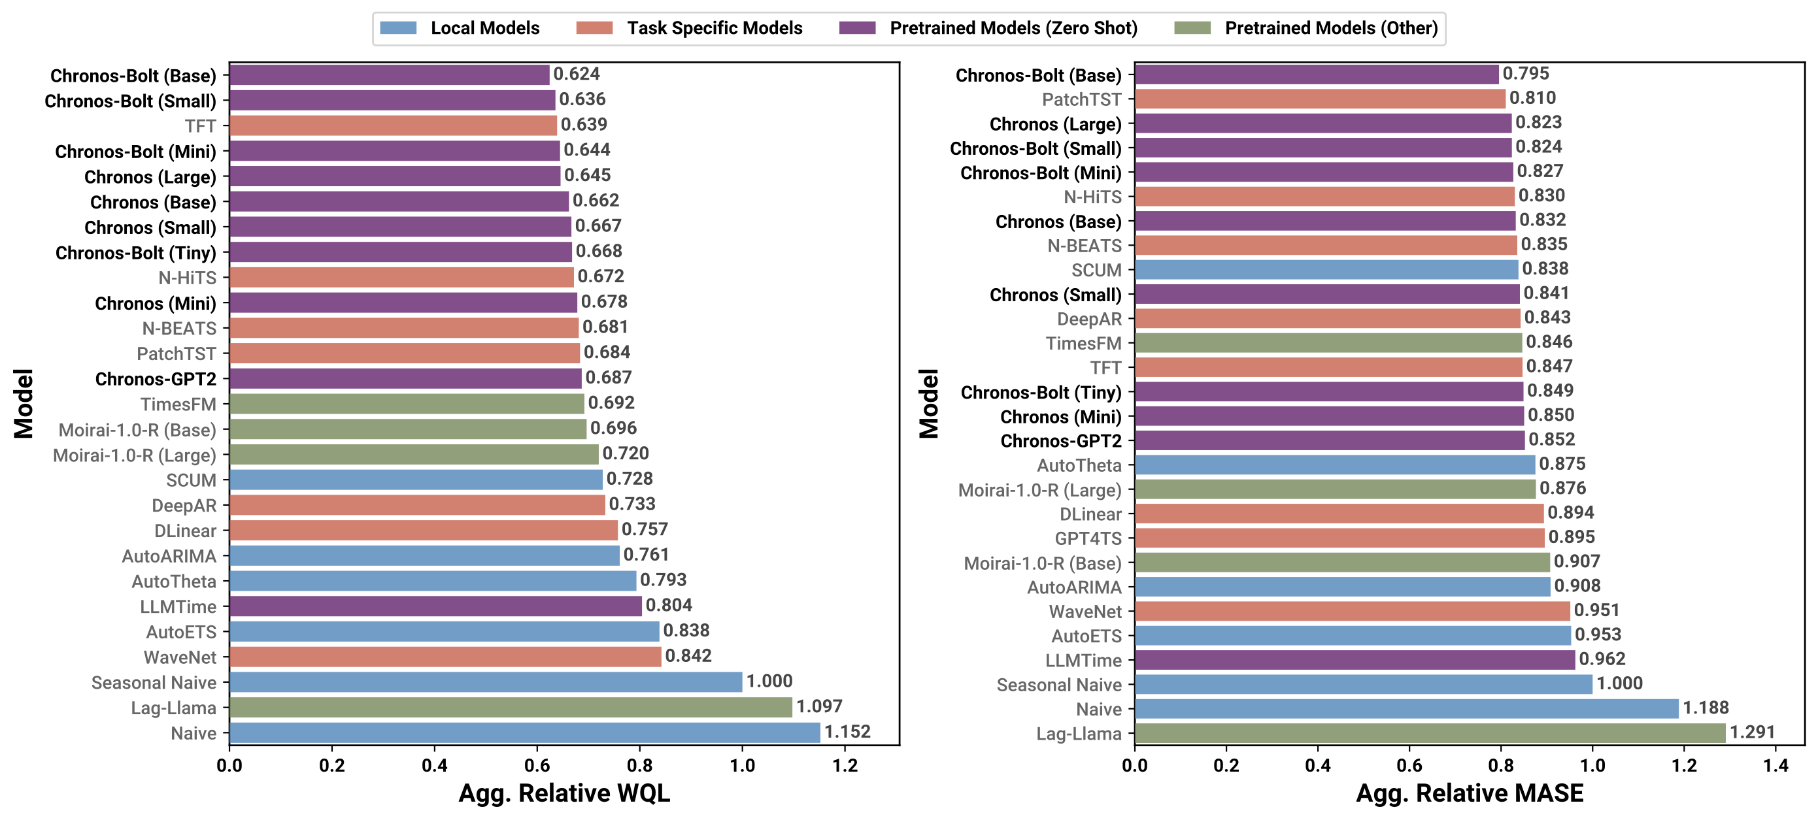
Chronos: zero-shot results
?
?
?
?
?
?
?
?
benchmark on 27 datasets not seen by Chronos models during training

Slide 17
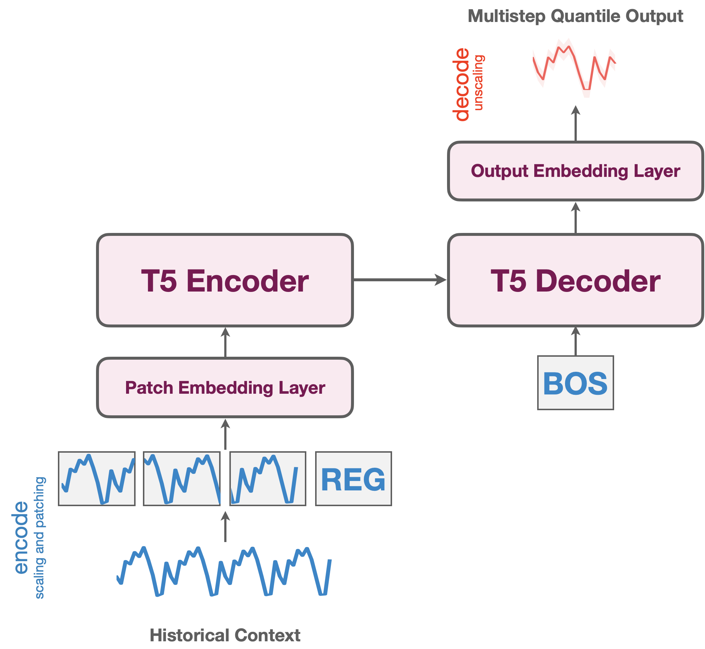
Introducing Chronos-Bolt⚡
More accurate and 250x faster than the original Chronos models
 | Chronos-Bolt | Chronos
Input (tokens) | Patches | Individual observations
Output (forecast) | Multi-step quantile forecast | Autoregressive sampling
Loss function | Quantile loss | Cross-entropy loss
Context length | 2048 | 512
Inference device | CPU or GPU | GPU

Slide 18
Chronos-Bolt: zero-shot results
benchmark on 27 datasets not seen by Chronos models during training

Slide 19
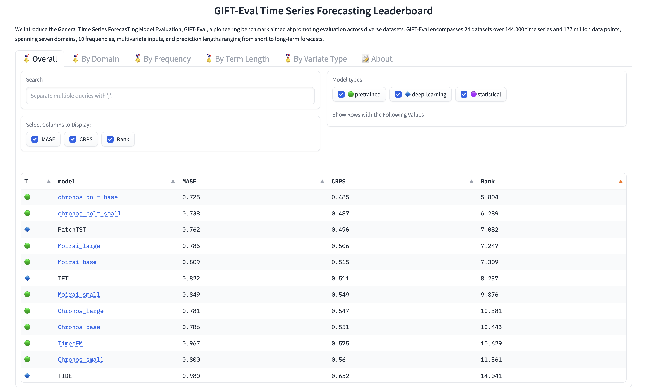
Chronos-Bolt tops the GIFT-Eval leaderboard
Link: https://huggingface.co/spaces/Salesforce/GIFT-Eval

Slide 20
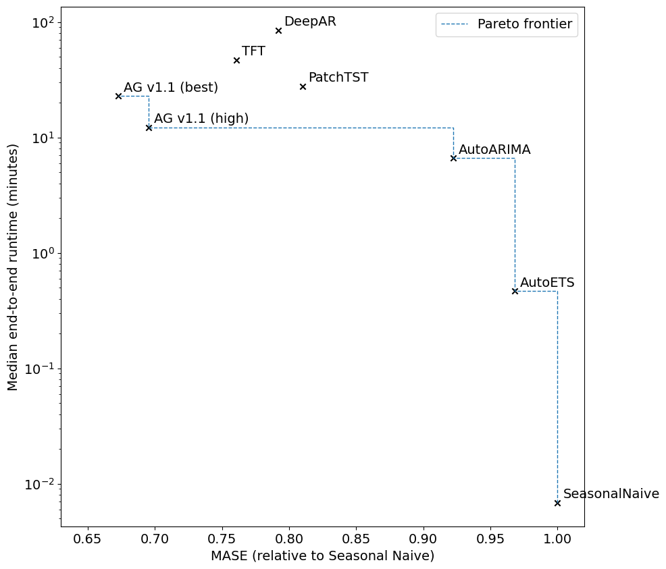
Speed-accuracy tradeoff
point forecast accuracy on a benchmark of 68 datasets

Slide 21
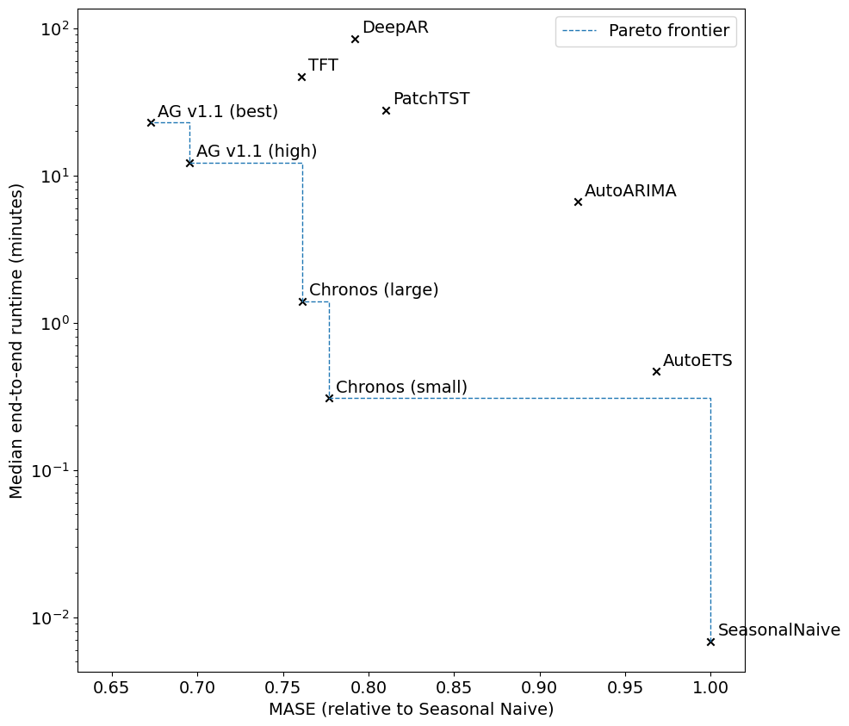
Chronos models extend the Pareto frontier
point forecast accuracy on a benchmark of 68 datasets

Slide 22
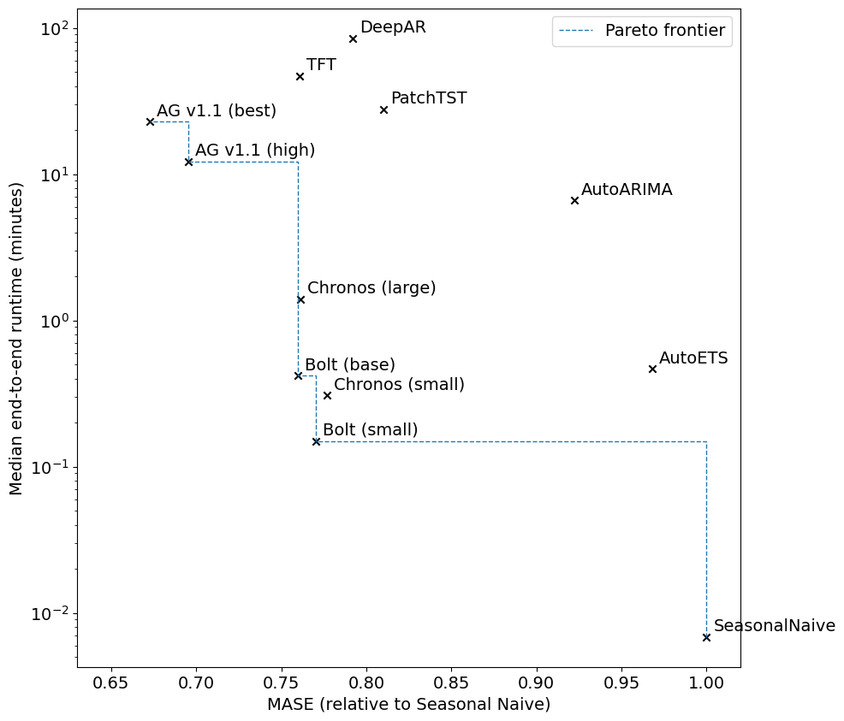
Chronos-Bolt is faster and more accurate
point forecast accuracy on a benchmark of 68 datasets

Slide 23
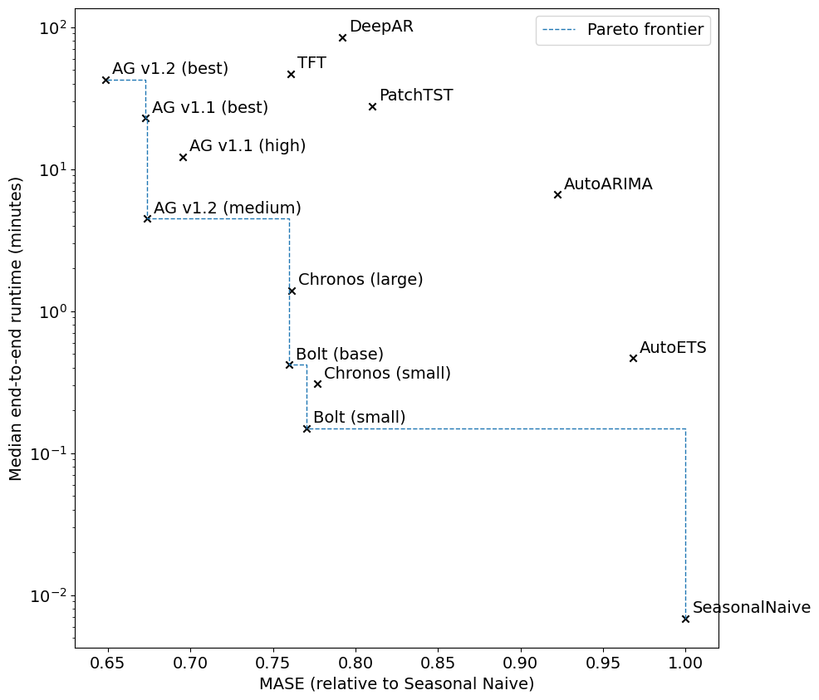
Ensemble with Chronos-Bolt for max accuracy
point forecast accuracy on a benchmark of 68 datasets

Slide 24
Chronos-Bolt in AutoGluon
Forecast with zero-shot Chronos-Bolt in one line of code
predictor.fit(data, presets="bolt_base").predict(data)

Slide 25
New in v1.2: Chronos fine-tuning
Fine-tune any Chronos model on a custom dataset
predictor.fit(
data,
hyperparameters={
"Chronos": {
"model_path": "bolt_small",
"fine_tune": True,
},
)

Slide 26
New in v1.2: Chronos + covariates
Combine Chronos with a regression model to handle the covariates
predictor.fit(
data,
hyperparameters={
"Chronos": {
"model_path": "bolt_small",
"covariate_regressor": "CAT", # CatBoost
},
)

Slide 27
What’s next for AutoGluon-TimeSeries?
New, better pretrained models
Zero-shot handling of covariates
Stack ensembling for time series forecasting
Better portfolios & presets for diverse use cases

Slide 28
Abdul Fatir Ansari
ansarnd@amazon.com

Slide 29
Backup

Slide 30
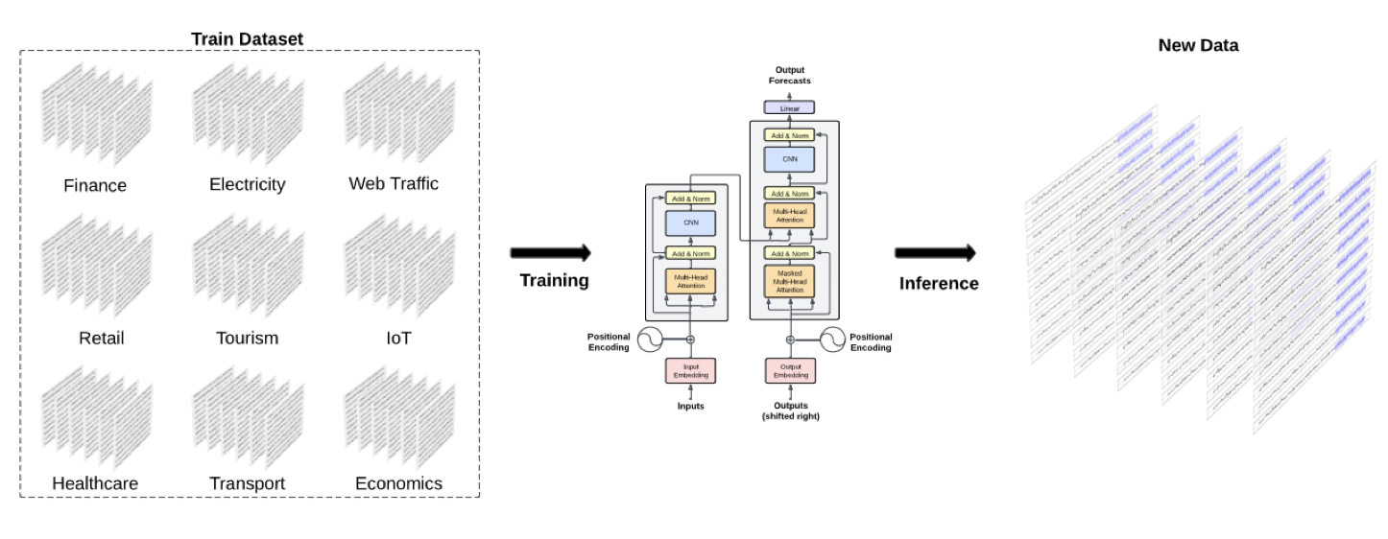
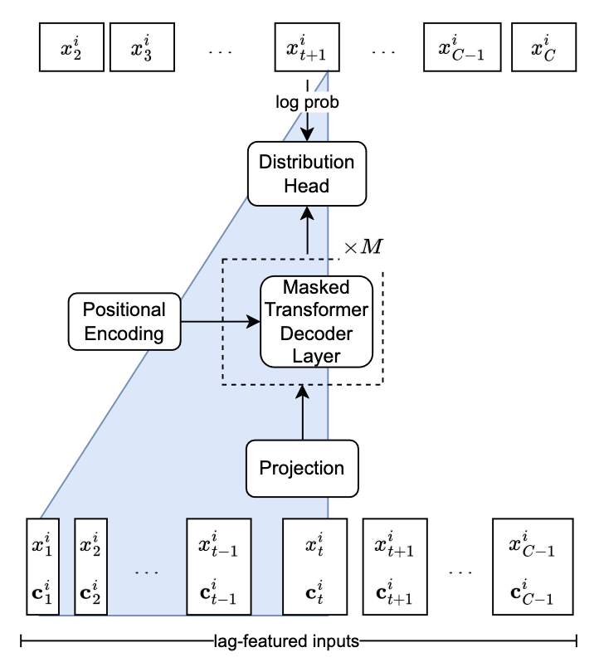
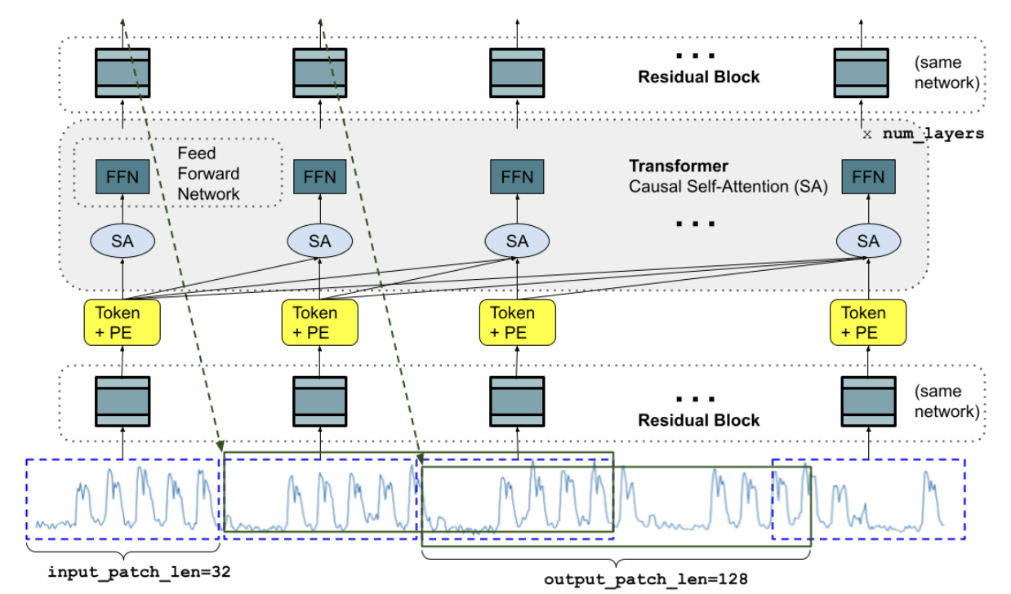
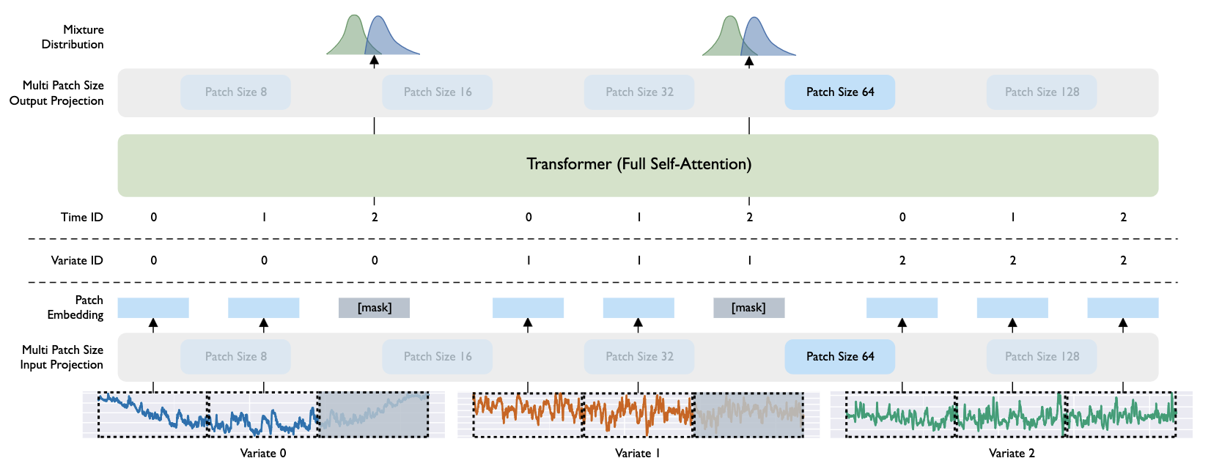
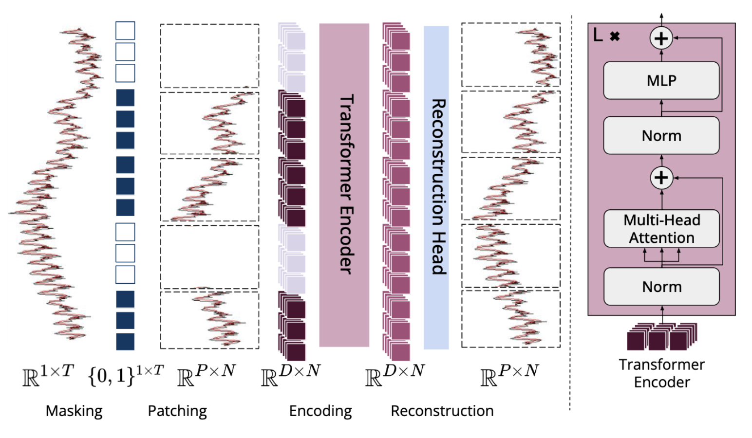
Other pretrained time series models
TimeGPT (Nixtla)
LagLlama
TimesFM (Google)
Moirai (Salesforce)
MOMENT (CMU)

Slide 31
Baseline models
Pretrained models
Task-specific models
Local models
Single pretrained model used across all tasks
LLMTime
ForecastPFN
LagLlama
Moirai
TimesFM
Separate model trained / fine-tuned for each task
PatchTST
DeepAR
WaveNet
TFT
DLinear
NBEATS
NHiTS
GPT4TS
Separate model trained for each time series
Naive
SeasonalNaive
AutoETS
AutoARIMA
AutoTheta

Slide 32
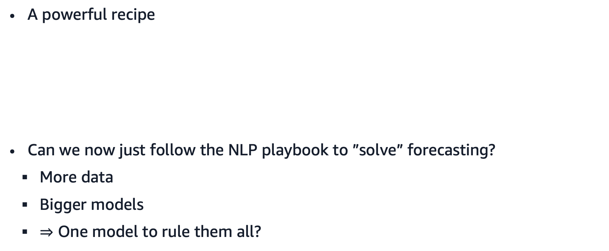
Is forecasting now “solved”?
A powerful recipe
Can we now just follow the NLP playbook to ”solve” forecasting?
More data
Bigger models
$⇒$ One model to rule them all?
Lots of data
Large transformer model
Accurate zero-shot forecaster

Slide 33
Why AutoML is the future of forecasting
Pretrained forecasting models are fast & cheap (by LLM standards)
Many ways to improve a single model!
Preprocessing, fine-tuning, calibration, conformal prediction, …
Many ways to combine models!
Ensembling, stacking, boosting, …

Slide 34
Pretrained models in the AutoML toolbox
Preprocessing
Model portfolio
Adaptation
Ensembling
Preprocessing can improve accuracy
Scaling
Box-Cox transform
Outlier removal
…
Collection of (small) pre-trained models
Chronos
TimesFM
MOIRAI
…
Adapt pretrained models to the task at hand
Fine-tuning
Calibration
Conformal prediction
…
Combine several models into an ensemble
Boosting
Stacking
Linear ensembles
…

Slide 35
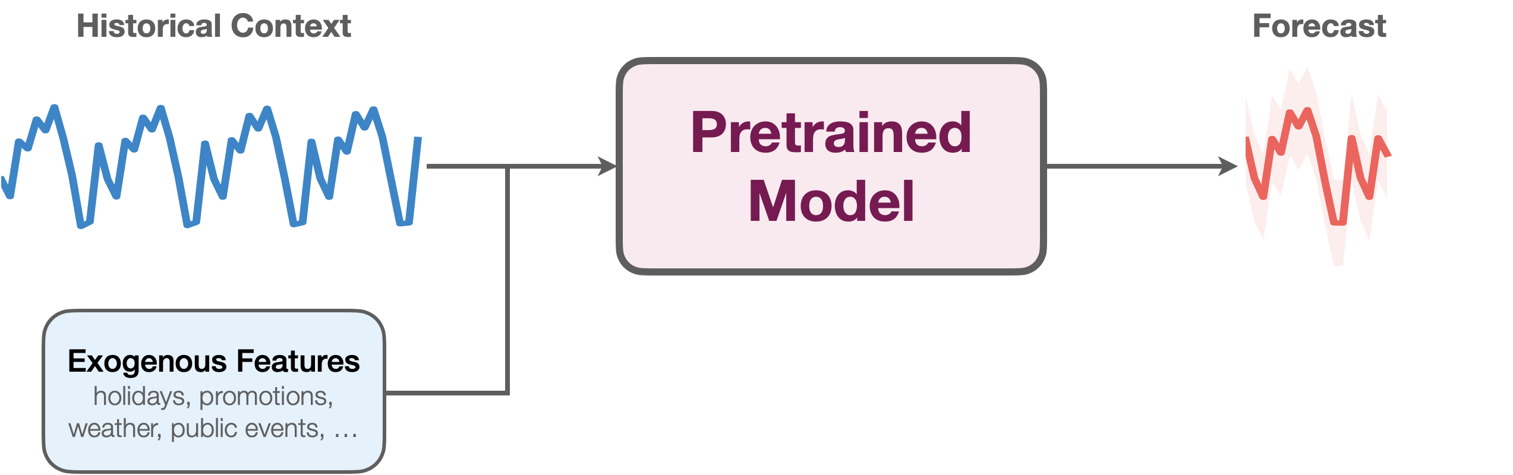
Beyond univariate forecasting
Covariates may provide important exogenous information
Challenge: Number and type of covariates are not known a priori

Slide 36
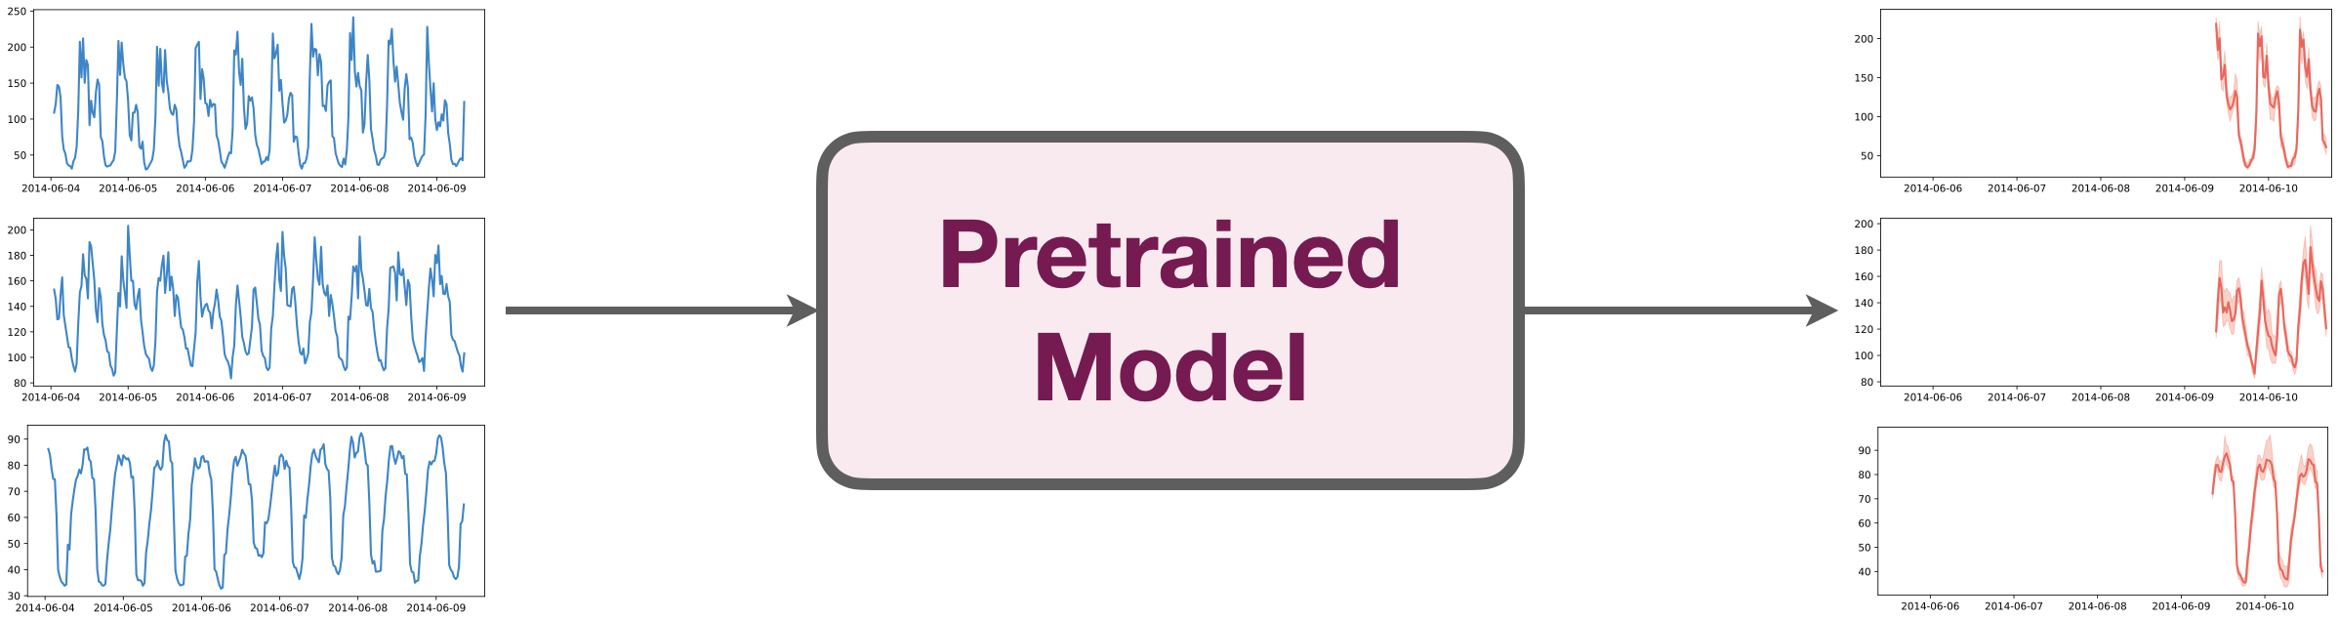
Multivariate forecasting
Joint modeling of multi-dimensional time series
Challenge: Number of dimensions and their interactions not known a priori

